Slide 1

Computer System in Accounting
Ajay Singh

Slide 2



Agenda
Introduction to or meaning of Computer
Elements/Components of Computer
Characteristics/features of Computer
Advantages and Disadvantages
Application areas
Computer System in Accounting
Process of Computing System in Accounting
Importance of Computer System in Accounting
Limitations of Computer System in Accounting
Difference between Manual and Computerized Accounting

Slide 3

Introduction
To Computer

Slide 4




Introduction
A computer is an electronic device that is designed to receive, store, process, and output data. It is a powerful tool that has become an integral part of our daily lives. The computer has evolved over the years from its early beginnings as a simple calculator to a complex machine that can perform millions of calculations per second.

Slide 5
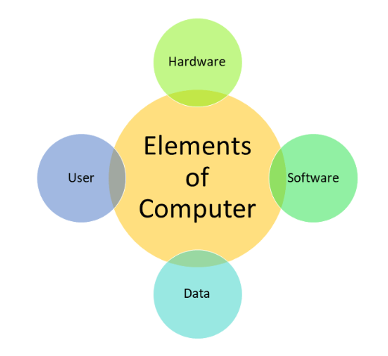
Elements of Computer
Hardware: This refers to the physical components of the computer that you can touch and see.
Software: This refers to the programs and instructions that tell the hardware what to do.
User: Person who operates the computer to accomplish certain task or objective.
Data: Information that is under processing or storage.

Slide 6
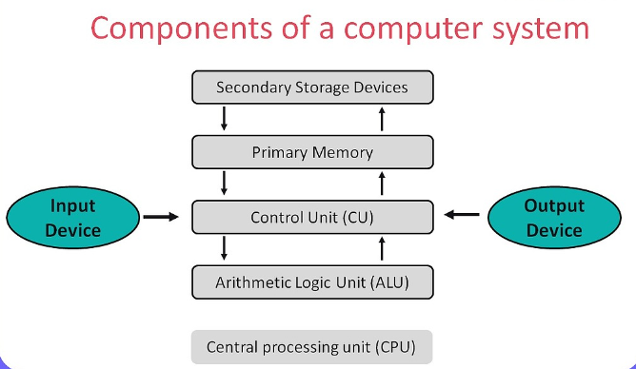
Components of Computer
Hardware
Central Processing Unit (CPU): This is the "brain" of the computer that performs most of the calculations and processes data.
Random Access Memory (RAM): This is the temporary memory that the computer uses to store data while it is working on it.
Hard Disk Drive (HDD) or Solid-State Drive (SSD): These are the primary storage devices that hold all the data and software installed on the computer.
Input devices: These are the devices that allow users to enter data into the computer, such as the keyboard and mouse.
Output devices: These are the devices that display information from the computer, such as the monitor or printer.
Motherboard: This is the main circuit board that connects all the hardware components of the computer.

Slide 7
Characteristics(features) of Computer
S
Speed: Computers can process and execute tasks much faster than humans. They can perform millions of calculations per second, making them ideal for processing large amounts of data quickly.
A
Accuracy: Computers are incredibly accurate and do not make mistakes if they are programmed correctly. They are also able to perform repetitive tasks without getting tired or making errors due to fatigue.
V
Versatility: Computers are incredibly versatile and can be used for a wide range of tasks. They can be used for everything from word processing to gaming to scientific research.
A
R
Reliability: Computers must be reliable and able to perform their intended functions without failure or error. This is especially important for systems that are used for critical tasks such as medical equipment, financial transactions, or air traffic control systems.
Automation: Computers can automate many tasks, making them ideal for tasks that are repetitive or require a high degree of precision.
D
Diligence: Computers must also be diligent, performing tasks with accuracy and attention to detail. A diligent system should be able to perform tasks quickly and efficiently, while also minimizing errors and mistakes. This is important for systems that require a high level of precision, such as scientific simulations or engineering design software.
S
Storage: Computers are able to store vast amounts of data in a very small space. This makes it easy to access and organize information quickly and efficiently.

Slide 8

Advantages of using Computer

Slide 9
Advantages of using Computer
Increased Efficiency: Computers can perform tasks much faster and more accurately than humans, allowing for increased efficiency and productivity. They can also automate repetitive tasks, freeing up time for employees to focus on more complex tasks.
Improved Communication: Computers and the internet have revolutionized communication by allowing people to connect instantly and easily from anywhere in the world. This has made it easier for businesses to communicate with customers and suppliers, and for individuals to stay connected with friends and family.
Access to Information: The internet provides access to a vast amount of information on any topic, making it easier for individuals and businesses to conduct research and make informed decisions.
Cost Savings: Computers can help businesses save money by reducing the need for manual labor, decreasing the amount of paper and other resources used, and reducing the need for office space.
Increased Accuracy: Computers can perform tasks with a high degree of accuracy and consistency, reducing the risk of errors and mistakes.
Better Data Management: Computers make it easy to store, organize, and analyze large amounts of data quickly and efficiently. This can help businesses make more informed decisions and improve their operations.
Enhanced Creativity: Computers provide a platform for creative expression, allowing individuals to create and edit digital media, develop software and apps, and design websites and graphics.

Slide 10
Disadvantages of using Computer

Slide 11
Disadvantages of using Computer
Dependence: Over-reliance on computers can lead to a loss of independence and the ability to think critically and creatively.
Health Risks: Extended use of computers can cause physical health problems such as eye strain, back pain, and repetitive strain injuries (RSIs).
Security Risks: Computers are vulnerable to viruses, malware, and other security threats that can compromise sensitive data and information.
High Cost: Purchasing and maintaining computer hardware and software can be expensive, especially for businesses and organizations.
Technical Issues: Computers can be complex and require technical knowledge to troubleshoot and repair. Technical issues can also cause downtime and disrupt productivity.
Job Loss: Automation and computerization can lead to job loss in certain industries, as machines and software replace human labor.
Social Isolation: Increased use of computers and technology can lead to social isolation and decreased face-to-face communication, which can have negative effects on mental health and well-being.

Slide 12
Application areas of Computers

Slide 13
Application areas of Computers
Business and Finance: Computers are widely used in business and finance for tasks such as accounting, payroll processing, financial analysis, and market research.
Education: Computers are used in education for tasks such as teaching, research, and student administration. They also provide access to online learning resources and educational software.
Healthcare: Computers are used in healthcare for tasks such as electronic medical record-keeping, medical imaging, and patient monitoring.
Entertainment: Computers are used in the entertainment industry for tasks such as video and audio production, animation, and game development.
Science and Engineering: Computers are used in science and engineering for tasks such as data analysis, modeling and simulation, and design and testing.
Communications: Computers are used in communications for tasks such as email, instant messaging, and video conferencing.
Transportation: Computers are used in transportation for tasks such as air traffic control, logistics management, and vehicle control systems.
Government and Public Services: Computers are used in government and public services for tasks such as data management, public safety, and e-government services.

Slide 14
Computer System in Accounting
Computer systems have become essential in modern accounting because they can significantly improve the efficiency and accuracy of financial record-keeping and reporting. Here are some ways in which computer systems are used in accounting:

Slide 15
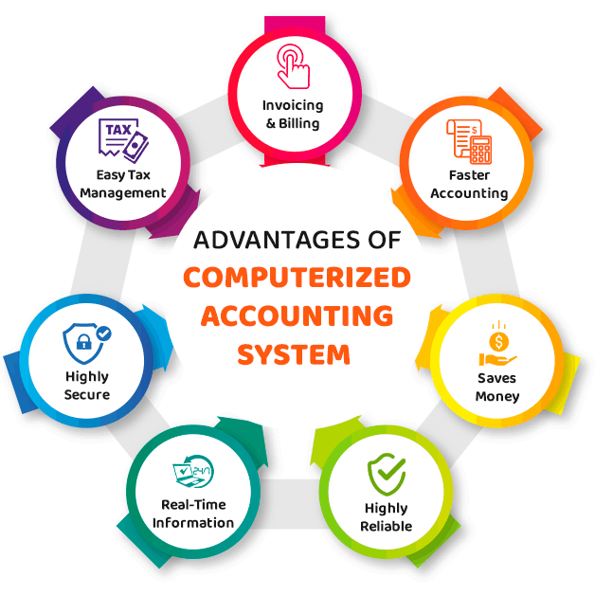
Computer System in Accounting
Bookkeeping: Computers are used to record financial transactions such as sales, purchases, and expenses in accounting software. This process is more accurate and efficient than manual bookkeeping.
Payroll Processing: Computers can automate the process of calculating and distributing employee payroll, making it faster and more accurate.
Financial Reporting: Computer systems can generate financial statements such as balance sheets, income statements, and cash flow statements with ease and accuracy, reducing the potential for errors.
Tax Filing: Computer systems can automate the process of filing tax returns and keeping track of tax obligations, helping businesses comply with tax regulations.
Auditing: Computer systems can help auditors by providing easy access to financial data, automating auditing tasks, and flagging potential errors or fraud.
Data Analysis: Computer systems can analyze large amounts of financial data quickly and accurately, providing valuable insights into a company's financial performance.

Slide 16
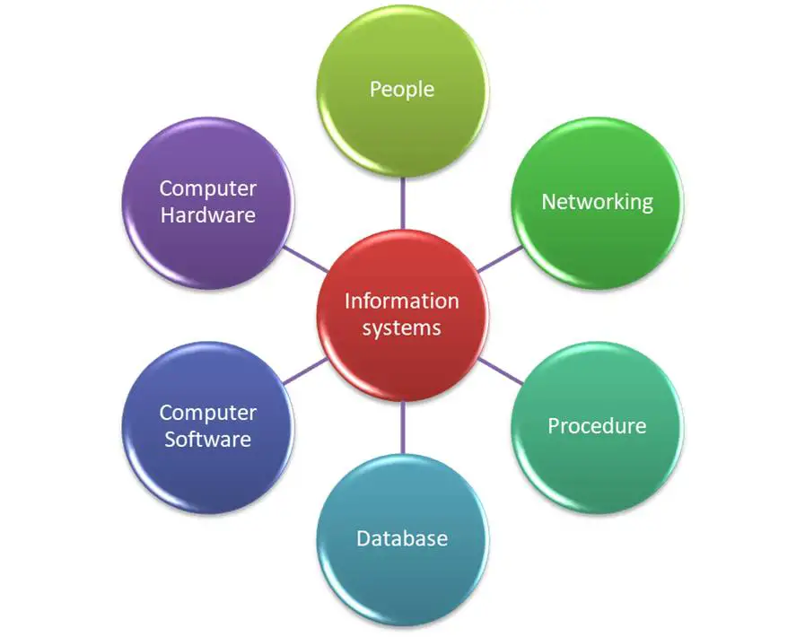
Elements of Computing System in Accounting
The elements of a computing system in accounting include:
Hardware: This includes the physical components of a computer system such as the central processing unit (CPU), monitor, keyboard, and mouse.
Software: This refers to the programs and applications used to process and store financial data, including accounting software, spreadsheet software, and database management systems.
Data: This is the information that is input into the computer system, including financial transactions, customer data, and vendor information.
Procedures: This includes the standard operating procedures and best practices for using the computer system, including data entry, backup procedures, and data security protocols.
People: This includes the individuals who use the computer system to process financial data, including accounting staff, auditors, and IT personnel responsible for maintaining the system.

Slide 17
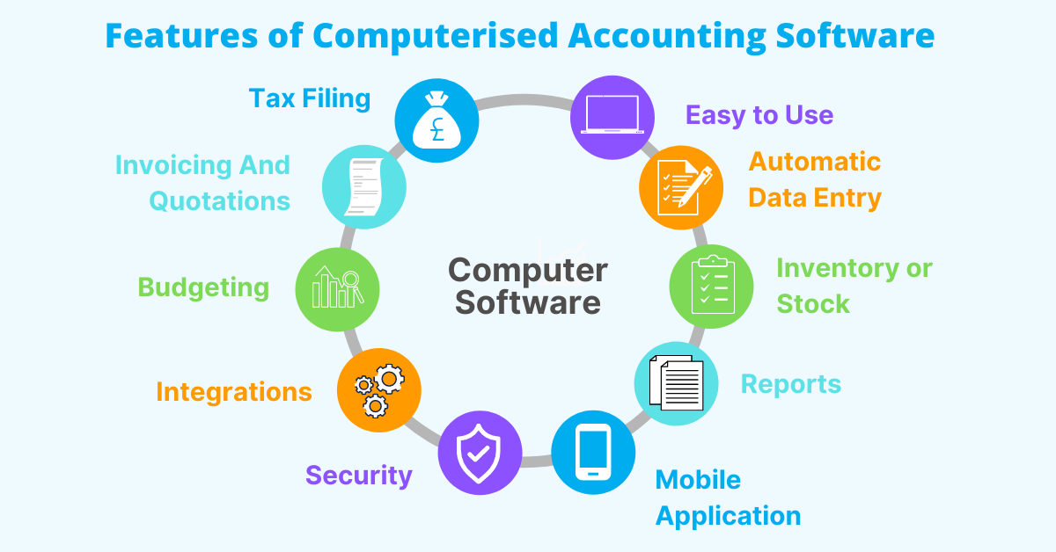
Features of Computing System in Accounting
The features of a computing system in accounting include:
Accuracy: A computing system ensures that accounting data is recorded accurately and consistently, reducing the likelihood of errors caused by manual data entry.
Speed: A computing system can process large amounts of financial data in a short amount of time, making it easier to generate reports and financial statements quickly.
Storage: A computing system can store large amounts of financial data in an organized and easily accessible format, allowing for quick retrieval of important financial information.
Security: A computing system can be designed with multiple layers of security, including user authentication, data encryption, and backup procedures, to protect financial data from theft, fraud, or loss.
Scalability: A computing system can be easily scaled up or down to meet the changing needs of an organization, including adding new users or expanding storage capacity.
Reporting: A computing system can generate detailed financial reports, providing a real-time view of an organization's financial health and enabling informed decision-making.
Integration: A computing system can integrate with other software systems, including enterprise resource planning (ERP) systems, customer relationship management (CRM) systems, and payment processing systems, streamlining financial transactions across an organization.

Slide 18
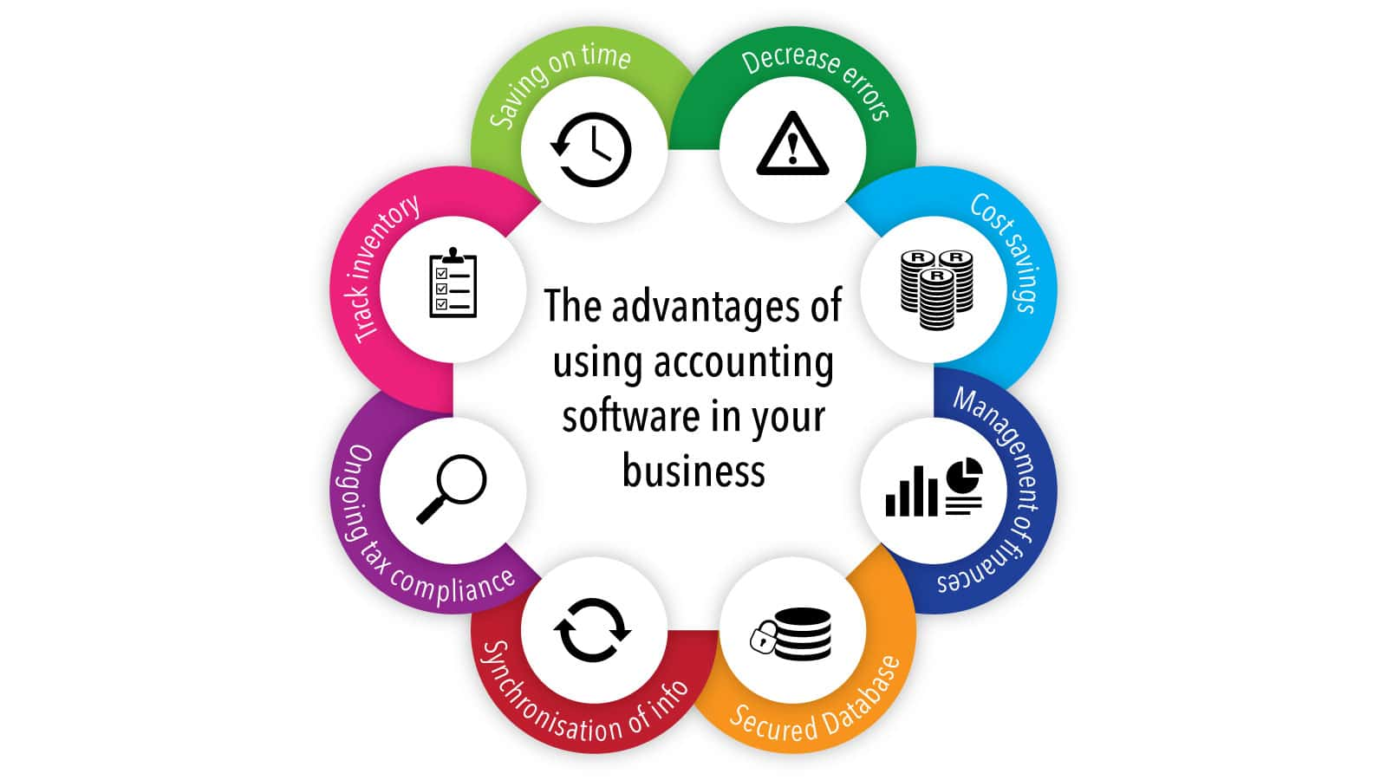
Importance of Computing System in Accounting
A computing system is crucial for accounting because it provides numerous benefits, including:
Accuracy: A computing system can reduce the potential for errors caused by manual data entry and calculations, ensuring accurate financial records.
Efficiency: A computing system can process large amounts of financial data quickly, reducing the time and effort required for routine accounting tasks.
Cost savings: A computing system can reduce the need for manual labor, including data entry and bookkeeping, which can result in significant cost savings for an organization.
Timeliness: A computing system can provide real-time access to financial data, enabling timely decision-making and reducing the potential for errors caused by outdated information.
Security: A computing system can protect financial data from theft, fraud, and other security threats, providing peace of mind for both management and customers.
Compliance: A computing system can help ensure compliance with accounting regulations and standards, reducing the risk of penalties and legal consequences.
Analysis: A computing system can generate detailed financial reports and analytics, enabling management to make informed decisions based on accurate and timely data.

Slide 19
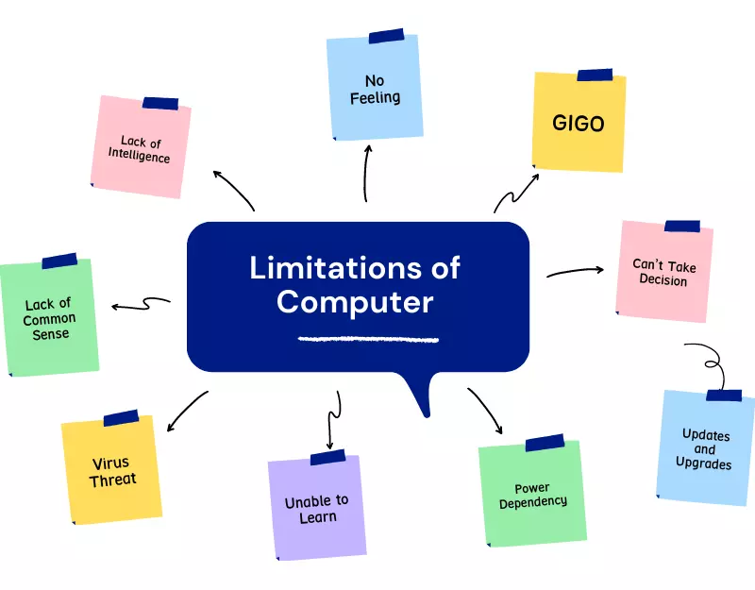
Limitations of Computing System in Accounting
While a computing system in accounting offers many advantages, there are also limitations, including:
Complexity: The complexity of a computing system can make it difficult to use and require extensive training and technical support.
Technical issues: Technical problems such as hardware or software failures can result in loss of data and system downtime, causing disruptions in accounting operations.
Security risks: A computing system is vulnerable to security risks, such as cyber-attacks, data breaches, and unauthorized access, which can result in loss of sensitive financial data.
Cost: The initial cost of purchasing and implementing a computing system can be high, as can the ongoing costs of maintenance and upgrades.
Dependence on technology: Organizations may become too reliant on computing systems, which can make it difficult to revert to manual accounting processes in the event of technical problems.
Incompatibility with legacy systems: Some computing systems may not be compatible with existing legacy systems, making it difficult to integrate accounting processes across an organization.
Lack of human judgment: A computing system can only process data based on predefined rules and algorithms and lacks the human judgment and intuition that can be critical in complex accounting situations.

Slide 20
Difference between Manual and Computerized Accounting
Method of recording transactions: Manual accounting requires transactions to be recorded by hand in ledgers or journals, while computerized accounting records transactions electronically using accounting software.
Speed: Computerized accounting is much faster than manual accounting, allowing for real-time updates and faster generation of reports and financial statements.
Accuracy: Computerized accounting is generally more accurate than manual accounting because it reduces the potential for errors caused by manual data entry and calculation.
Scalability: Computerized accounting is more scalable than manual accounting, as it can handle larger amounts of data and can be easily expanded to accommodate growth.
Cost: Manual accounting is generally less expensive than computerized accounting because it does not require the purchase of specialized software and hardware.
Security: Computerized accounting can provide better security for financial data than manual accounting, as it can include multiple layers of security, including user authentication and data encryption.
Learning curve: Computerized accounting requires more training and technical expertise than manual accounting, as users need to be familiar with the software and hardware used.
Manual accounting and computerized accounting are two different methods of recording financial transactions. The main differences between manual and computerized accounting are:

Slide 21
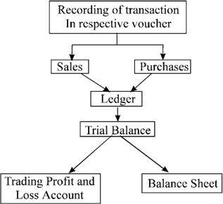
Process of Computing System in Accounting
The process of a computer system in accounting typically involves several stages, including:
Data Entry: Financial transactions are recorded in accounting software or systems through various methods, including manual entry or automatic import from other systems.
Classification and Coding: Once the data is entered, it is classified and coded according to a chart of accounts that outlines specific categories and subcategories for financial transactions.
Posting: The data is then posted to the appropriate accounts in the general ledger, which is the central repository of all financial transactions for an organization.
Adjusting Entries: Adjusting entries are made to the general ledger to ensure that financial statements accurately reflect the financial status of the organization, including adjustments for accruals, depreciation, and amortization.
Financial Statements: Financial statements such as the balance sheet, income statement, and cash flow statement are generated using accounting software, providing an overview of the organization's financial performance.
Analysis: Data analysis is performed on the financial statements to identify trends, patterns, and anomalies in the data. This analysis helps to inform financial decision-making.
Reporting: Financial reports are generated and shared with stakeholders, including management, investors, and regulators.

Slide 22
Process of Computerized in Accounting System
The process of computerized accounting system involves the following steps:
Selecting the appropriate accounting software: The first step in implementing a computerized accounting system is to select the appropriate accounting software that meets the specific needs of the organization.
Setting up the system: Once the accounting software has been selected, the system needs to be set up, which involves creating company files, setting up accounts, and defining the chart of accounts.
Entering transaction data: Once the system is set up, transaction data needs to be entered into the accounting software. This can be done manually or by importing data from other systems, such as point-of-sale systems or bank statements.
Processing transactions: Once the transaction data has been entered, the accounting software will process the transactions and update the appropriate accounts.
Generating reports: After processing transactions, reports can be generated, such as financial statements, general ledger, accounts receivable, accounts payable, and inventory reports.
Reconciling accounts: The accounting system should be reconciled regularly to ensure that the recorded transactions match the actual financial transactions.
Backing up data: Regular backups of the accounting system data should be performed to prevent data loss in case of hardware or software failure.
Performing maintenance and updates: The accounting system should be maintained and updated regularly to ensure that it is up-to-date with changes in accounting standards, tax laws, and software updates.

Slide 23
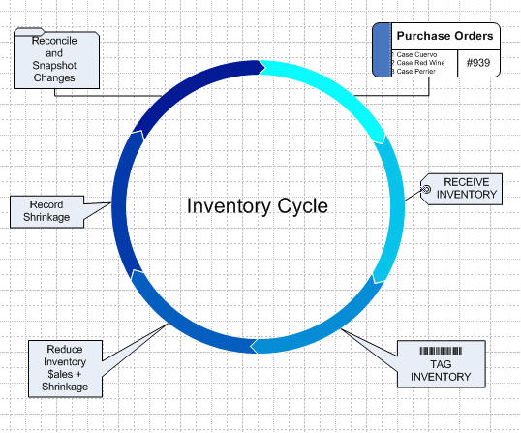
Computer System Process: Information Sources in Computer System
In a computerized accounting system, there are various sources of information that are used to record financial transactions. These sources of information include:
Bill: A bill is a document that outlines the goods or services purchased by an organization. When a bill is received, it is entered into the accounting system as an account payable.
Purchase order: A purchase order is a document that is used to order goods or services from a vendor. Once a purchase order is issued, it is entered into the accounting system as an accounts payable.
Goods receipt: A goods receipt is a document that is used to confirm the receipt of goods or services that have been ordered. Once a goods receipt is received, it is entered into the accounting system as an inventory transaction.
Barcode: Barcodes are used to track inventory in a computerized accounting system. When an item is received or sold, the barcode is scanned, and the transaction is recorded in the accounting system.

Slide 24


Thank You
Ajay Singh
ajay@mentormaya.com
https://ajaysingh.com.np

